Slide 1
Finnish Cyber Security Strategy
LTG Arto Räty
Permanent Secretary, Ministry of Defence of Finland
Chairman of the Security Committee of Finland
10.9.2015, Belgrade

Slide 2

Changing threat landscape
Natural resources
Climate change
Interdependence
Terrorism
Population growth
Technology
Global economy
Non-governmental actors

Slide 3

Cyber espionage on the rise (McAfee, Verizon)
Annual losses from cybercrime over $400 billion (McAfee)
Governments as the most important target (Symantec)
Notes:
T

Slide 4
Finland cannot be a successful and competitive welfare state without a safe cyber domain

Slide 5
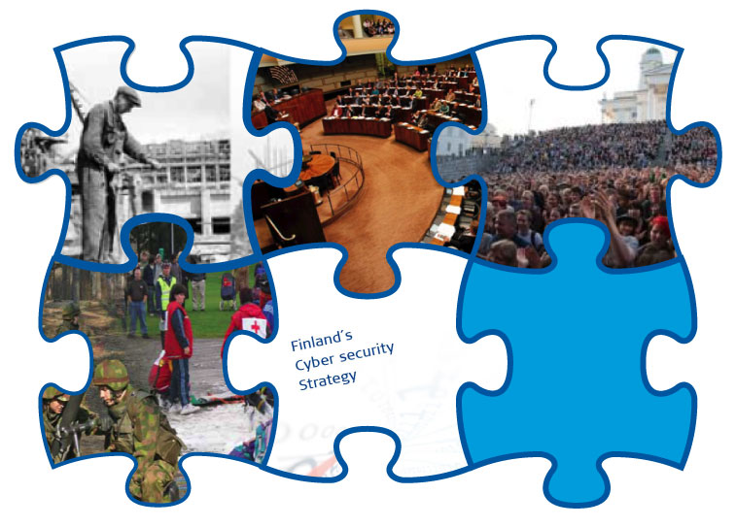
Comprehensive approach
Public – Private Partnerships

Slide 6
Principles of Crisis Management in Finland
President of the Republic
Government with its committees
Interministerial Cooperation Bodies
Ministry
C O M P E T E N T A U T H O R I T Y
Administration at central, regional and local levels
Supporting authorities, business life and civic organisations
National and international actors

Slide 7


Tasks of the Security Committee
To contribute to the preparedness of comprehensive security and its coordination
To monitor and evaluate Finland's security and defence policy environment and societal changes and their impacts on comprehensive security arrangements
To monitor the activities of different administrative sectors and levels to maintain and develop comprehensive security arrangements
To coordinate, if necessary, large and significant preparedness-related issues, such as national coordination of preparedness, development of forms of cooperation, operational models, research and training

Slide 8
Roadmap for the Cyber Security Strategy
Cabinet committee on foreign and security policy, headed by the President, decided in March 2011 to create a national cybersecurity strategy for Finland
In April 2011, a task force of 17 persons and secretariat of 7 persons was appointed
Main governmental security functions and organizations that represent private companies that command critical infrastructure were invited to participate
The strategy is based on the Security Strategy for Society and is a part of its implementation
2011 | Conduct preliminary study Identify focus areas for the strategy
2012 | Create the strategy Approve implementation plan for the strategy
2013-2015 | Implement the strategy Implement a continuous improvement process
2016 | Finland is global forerunner in cybersecurity

Slide 9
Cyber Security Strategy – factors to be concidered
Vision, Political will
Overall situational awareness
Threats, risks and vulnerabilities
Vital functions of society
Making full use of opportunities
Civil society
New business activities
Implementing cyber security
Guidance, structures, responsibilities and output
Capabilities = intelligence, protection, defence and influence
Coordination of projects and strategies
Competences
Training and education Development
Research
Legislation
National and international
Concepts and definitions
International cooperation

Slide 10
Cyber Security Strategy – Administration
POLITICAL GUIDANCE
Government (Cabinet Committee on Foreign and Security Policy): defining the cyber strategy policy, the resources of cyber security and the operational preconditions
COORDINATION
The Security and Defence Committee/Security Committee: the coordination of cyber security, follow-up of the implementation of the cyber security strategy and its further development
OPERATIONAL LEVEL
Administrative branches: preparedness and assigned cyber security tasks
Cyber Security Centre: cyber situation picture, coordination of counter-measures, informing and guiding

Slide 11
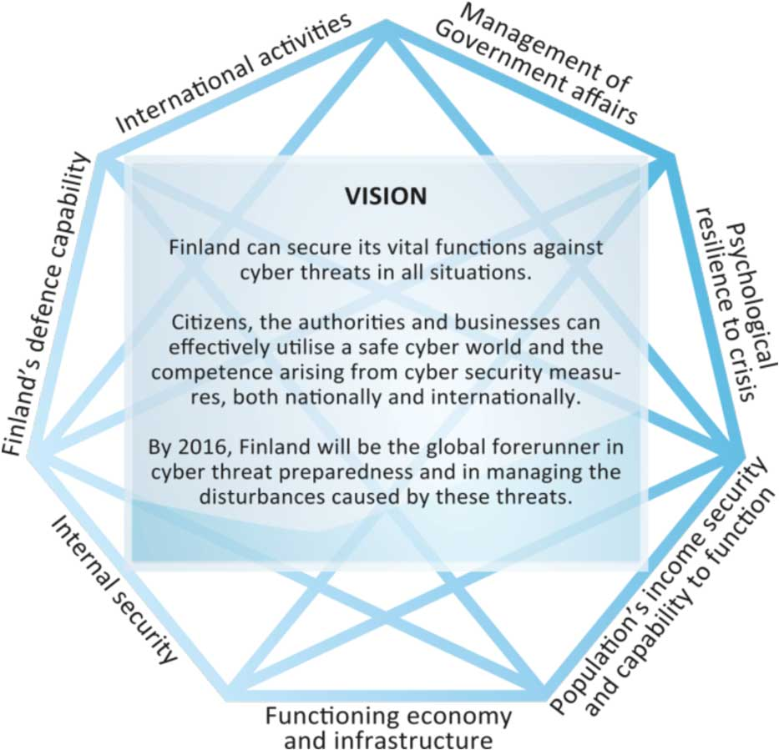
Cyber Security Strategy Vision

Slide 12








10 Cyber Security Guidelines
1. Collaboration model
2. Situational awareness
3. Continuity of preparedness
4. Capacities of
the police
5. Cyber defence
6. Enhanced international
co-operation
7. Education and training
= knowledge
8. Legislation
9. Tasks, requirements and service models
10. Monitoring the implementation

Slide 13

Roadmap
Strategy
Vision
Strategic guidelines
Memorandum
Securing the
vital functions
Implementation plan
Action items
Cyber security tasks
Implementation n
Plans of the ministries
24 JAN 2013
11 MAR 2014
2014
The strategy is a living document !

Slide 14

Implementation program
Main focus areas
Cyber Security Center
24/7 Information Security Operations of the Government
Security network for encrypted data transfer and administration
Police’s responding capabilities to cybercrime
Research and education programs, and improvement of other competences
Changes in legislation
    development of capabilities

Slide 15

Major Challenges
  Resources
  Full implementation of the National Security Network
  Roll-out of Government 24/7
  Information Security Operations
  Legislation
  Responsibilities and coordination
  in some areas
  Some organisations are lagging
  behind in their implemention of the
  Information Society Code

Slide 16

Implementation - where have we succeeded?
General knowledge and awareness!
Cyber Security Strategy and the implementation plan
Cyber Security Center and development of the CERT-FI
Research, training and education programmes
Innovation Centre in the city of Jyväskylä
Business Cyber Cluster (FISC) and their Cyber Laboratory
Working group on intelligence gathering
  - Report issued to Governement 14 Jan 2015
Improved Incident Response Procedures
Cooperation between different actors
Public-Private-Partnership!
International cooperation

Slide 17

NCSC-FI's role
Technical threats
Actions ISPs take
APT
HAVARO
Unknown threats
General threats
Non-technical threats: Scams, frauds etc.
End user controls
ISP = Internet Service Provider
APT = Advanced Persistent Threat
CIP = Critical Infrastructure Provider
Citizens
Government
CIP
Notes:
ISP = Internet Service Provider
APT = Advanced Persistent Threat
CIP = Critical Infrastructure Provider

Slide 18
First line – ISPs
Technical threats
Actions ISPs take
Malware, DDOS, APT…
APT
Communications market act, cleaning and disconnecting infected computers
HAVARO
Unknown threats
General threats
Non-technical threats: Scams, frauds etc.
End user controls
Citizens
Government
CIP

Slide 19
Result
Technical threats
Actions ISPs take
APT
HAVARO
Based on Microsoft Security Intelligence Report 16
”Finland has cleanest networks in the world”
Unknown threats
General threats
Non-technical threats: Scams, frauds etc.
End user controls
Citizens
Government
CIP

Slide 20
Second line – HAVARO
Technical threats
Actions ISPs take
APT
HAVARO
”Cleanest networks in the world”
Unknown threats
General threats
Non-technical threats: Scams, frauds etc.
Network Monitoring and Early Warning System
End user controls
Citizens
Government
CIP

Slide 21
Third line
Technical threats
Actions ISPs take
APT
HAVARO
”Cleanest networks in the world”
Unknown threats
General threats
Non-technical threats: Scams, frauds etc.
End user controls
Every stakeholder is
a security actor!
Citizens
Government
CIP

Slide 22

Finnish success factors
  Comprehensive concept
      Co-operation among authorities, businesses, and NGO’s
        - possibility to utilize existing
        knowledge and capabilities in Finland
    Cost-effectiveness!
  Shared awareness on the
  importance of cyber security
  Technology skills and knowledge

Slide 23
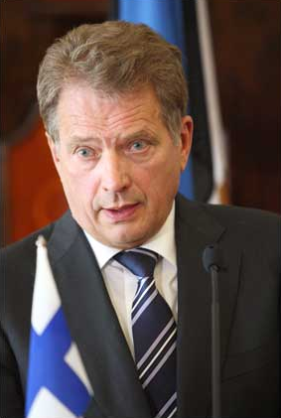
New legislation is needed
“Our key functions are more and more dependent on information technology and data networks.
Cyber influence forms a part of the picture of future conflicts separately or alongside other ways of applying pressure or using force.
While the cyber dimension is not pervasive, it is present. We still have much to do in this respect. We need new legislation. We need to put strategies into practice.
All this must be implemented without violating fundamental rights or the protection of privacy,”
- speech by President of the Republic
Sauli Niinistö at the opening
of Parliament on 4 February 2014

Slide 24

Finnish Information Society Code
New legislation, effective from 1.1.2015
10 different laws (490 §) into one code (350 §)
All relevant regulations concerning electric media gathered under the same code in order to
  foster the supply of electronic communications services and to ensure the availability of communication networks and services.
  secure the efficient and uninterrupted use of radio frequencies
  foster competition
  ensure that communications networks and services are technologically advanced, of high quality, reliable, safe, and inexpensive
  ensure the confidentiality of electronic communication and the protection of privacy

Slide 25
Working group on intelligence gathering - tasks
To gather views on the threats
To clarify the current situation of security authorities
To study legislation elsewhere
To provide various alternatives
To propose how to develop legislation and other measures

Slide 26

To be carefully considered
Accurate legislative definitions
”Mass surveillance” vs basic rights
Screening information with sufficient accuracy
Guarantee the confidentiality of a message
Finland’s reputation: securing national security interests and a credible defence, a safe environment for individuals and businesses
Minimum burdens on businesses
Impact assessments
Legal protection of the individual
Independent permission procedure
Organising surveillance and transparency
Notes:
Various issues have to be considered if you want to develop legislation on data gathering and intelligence.

